Slide 1

Smart Flight Booking and Management Digital Tool
Student Name: MURIHIRA MUHIRE Arsene
Student ID: 27656
December 2025
Adventist University of Central Africa (AUCA)

Slide 2

Problem Statement
Manual flight booking processes are time-consuming and error-prone
Lack of centralized system for managing flight reservations and passenger data
Difficulty tracking flight schedules, seat availability, and booking status in real-time
No integrated solution for managing cancellations, refunds, and customer communications
Airlines struggle with data consistency and reporting across multiple booking channels

Slide 3
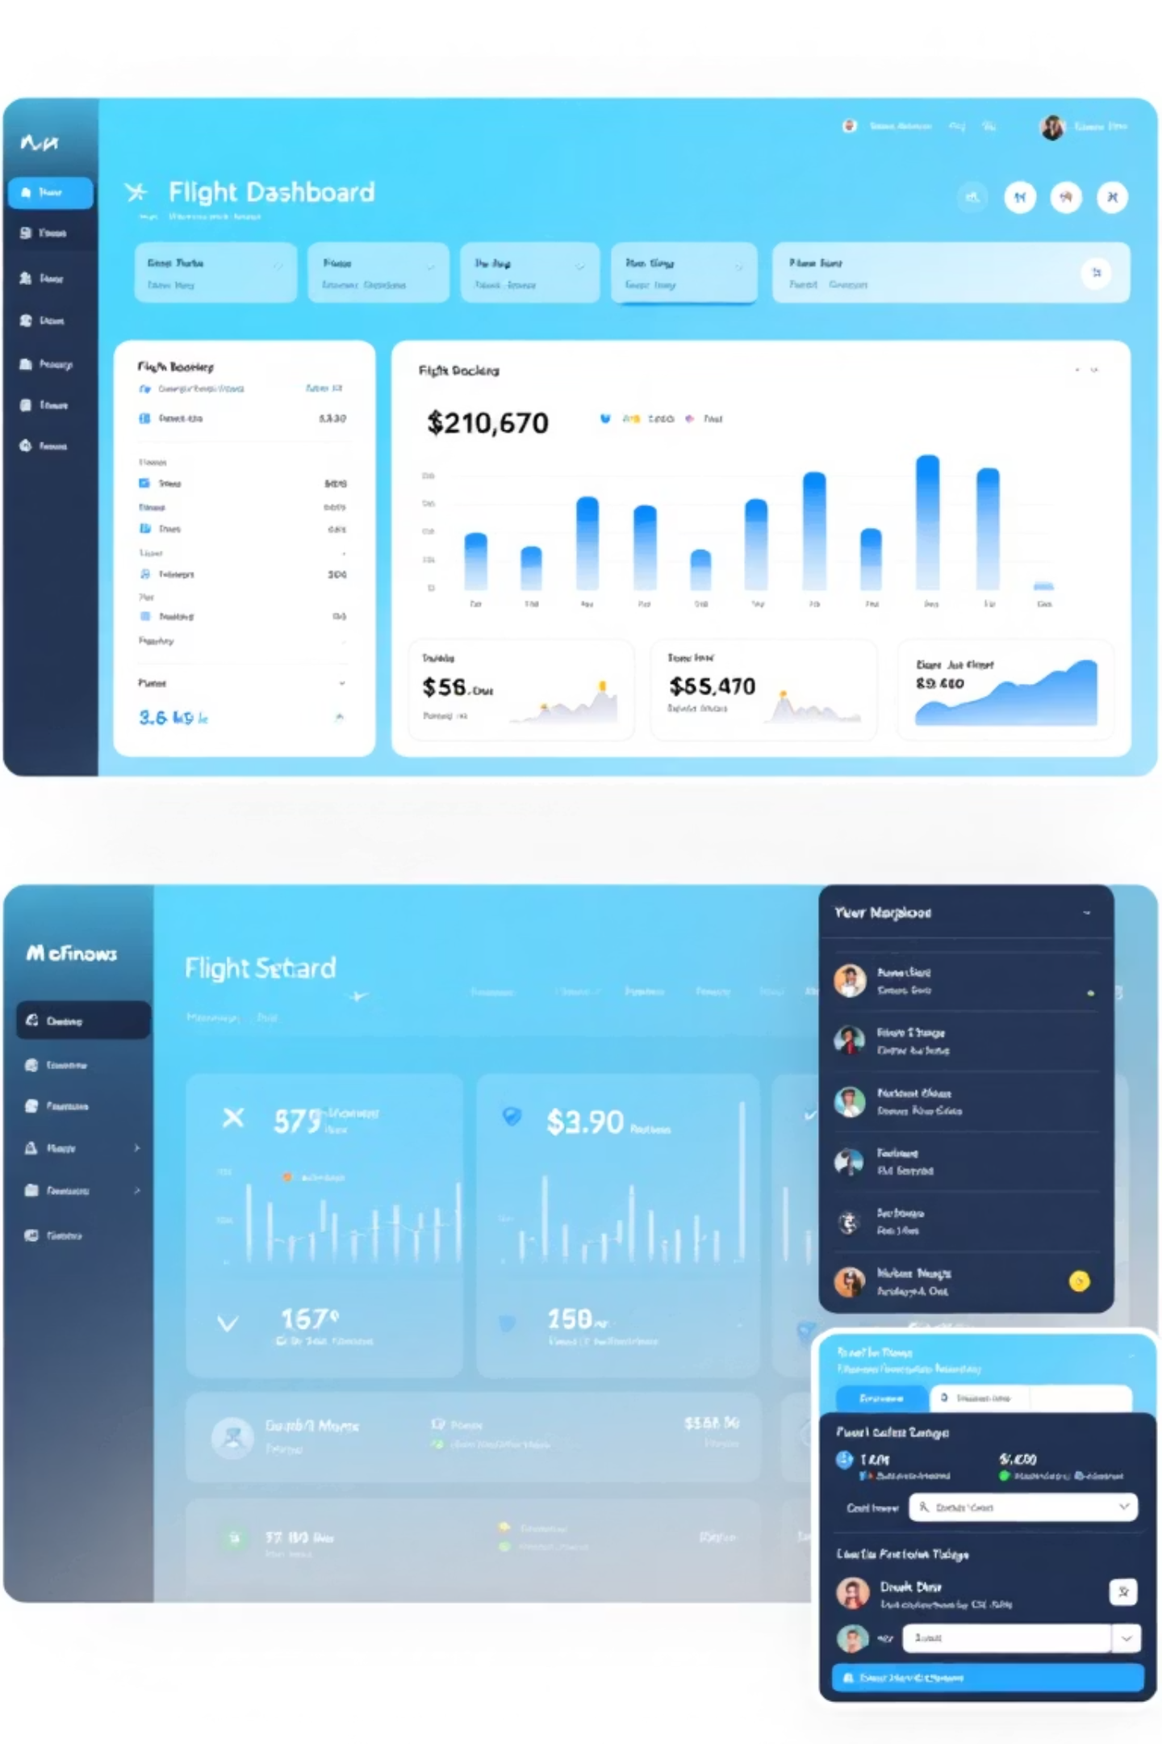
Solution & Project Objectives
Develop a comprehensive Oracle database-driven flight booking and management system
Centralize all flight, passenger, and booking data in a single, secure repository
Enable real-time tracking of flight schedules, seat availability, and booking status
Implement automated workflows for cancellations, refunds, and customer notifications
Provide analytics and reporting capabilities for business intelligence and decision-making
Ensure data integrity, security, and compliance with industry standards

Slide 4
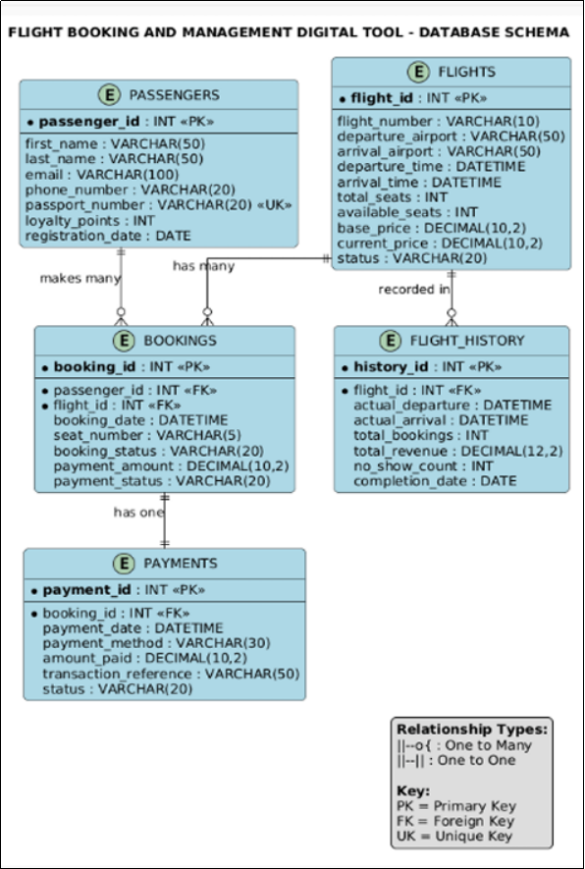
Database Design & Entity-Relationship Model
Airlines
Payments
Seats
Cancellations
Passengers
Bookings
Flights
This diagram illustrates the interconnectedness of our database, ensuring data integrity and efficient information flow across all modules of the system.

Slide 5
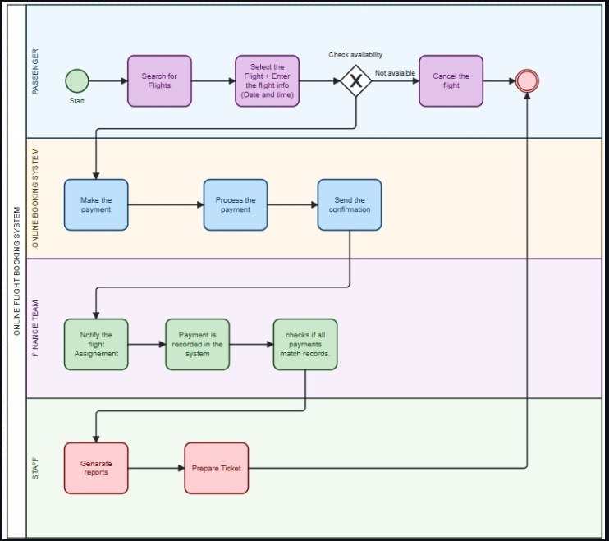

Business Process & Workflow
This comprehensive workflow ensures a smooth, transparent, and efficient experience for both customers and airline administrators, minimizing manual errors and maximizing operational effectiveness.

Slide 6

Technical Implementation & PL/SQL Development
Our solution is built on a robust foundation, leveraging Oracle Database capabilities and custom PL/SQL development to ensure performance, reliability, and data integrity:
Database Platform: Oracle Database with PL/SQL
Architecture: Normalized relational database (3NF minimum)
Data Integrity: Primary keys, foreign keys, and constraints enforced
Procedures: Custom PL/SQL procedures for booking, cancellation, and refund processing
Functions: Validation functions for passenger data, seat availability, and payment verification
Transactions: ACID-compliant transactions ensuring data consistency
Error Handling: Comprehensive exception handling and logging mechanisms

Slide 7

Advanced Features: Triggers, Auditing & Security
Database Triggers: Automated enforcement of business rules and data validation
Audit Logging: Comprehensive tracking of all INSERT, UPDATE, DELETE operations
Restriction Rules: Employees cannot modify data on weekdays or public holidays
Security Measures: Role-based access control and user authentication
Data Validation: Triggers ensure seat availability, payment verification, and booking integrity
Audit Trail: Complete history of all transactions for compliance and dispute resolution
Error Recovery: Automatic rollback mechanisms for failed transactions

Slide 8
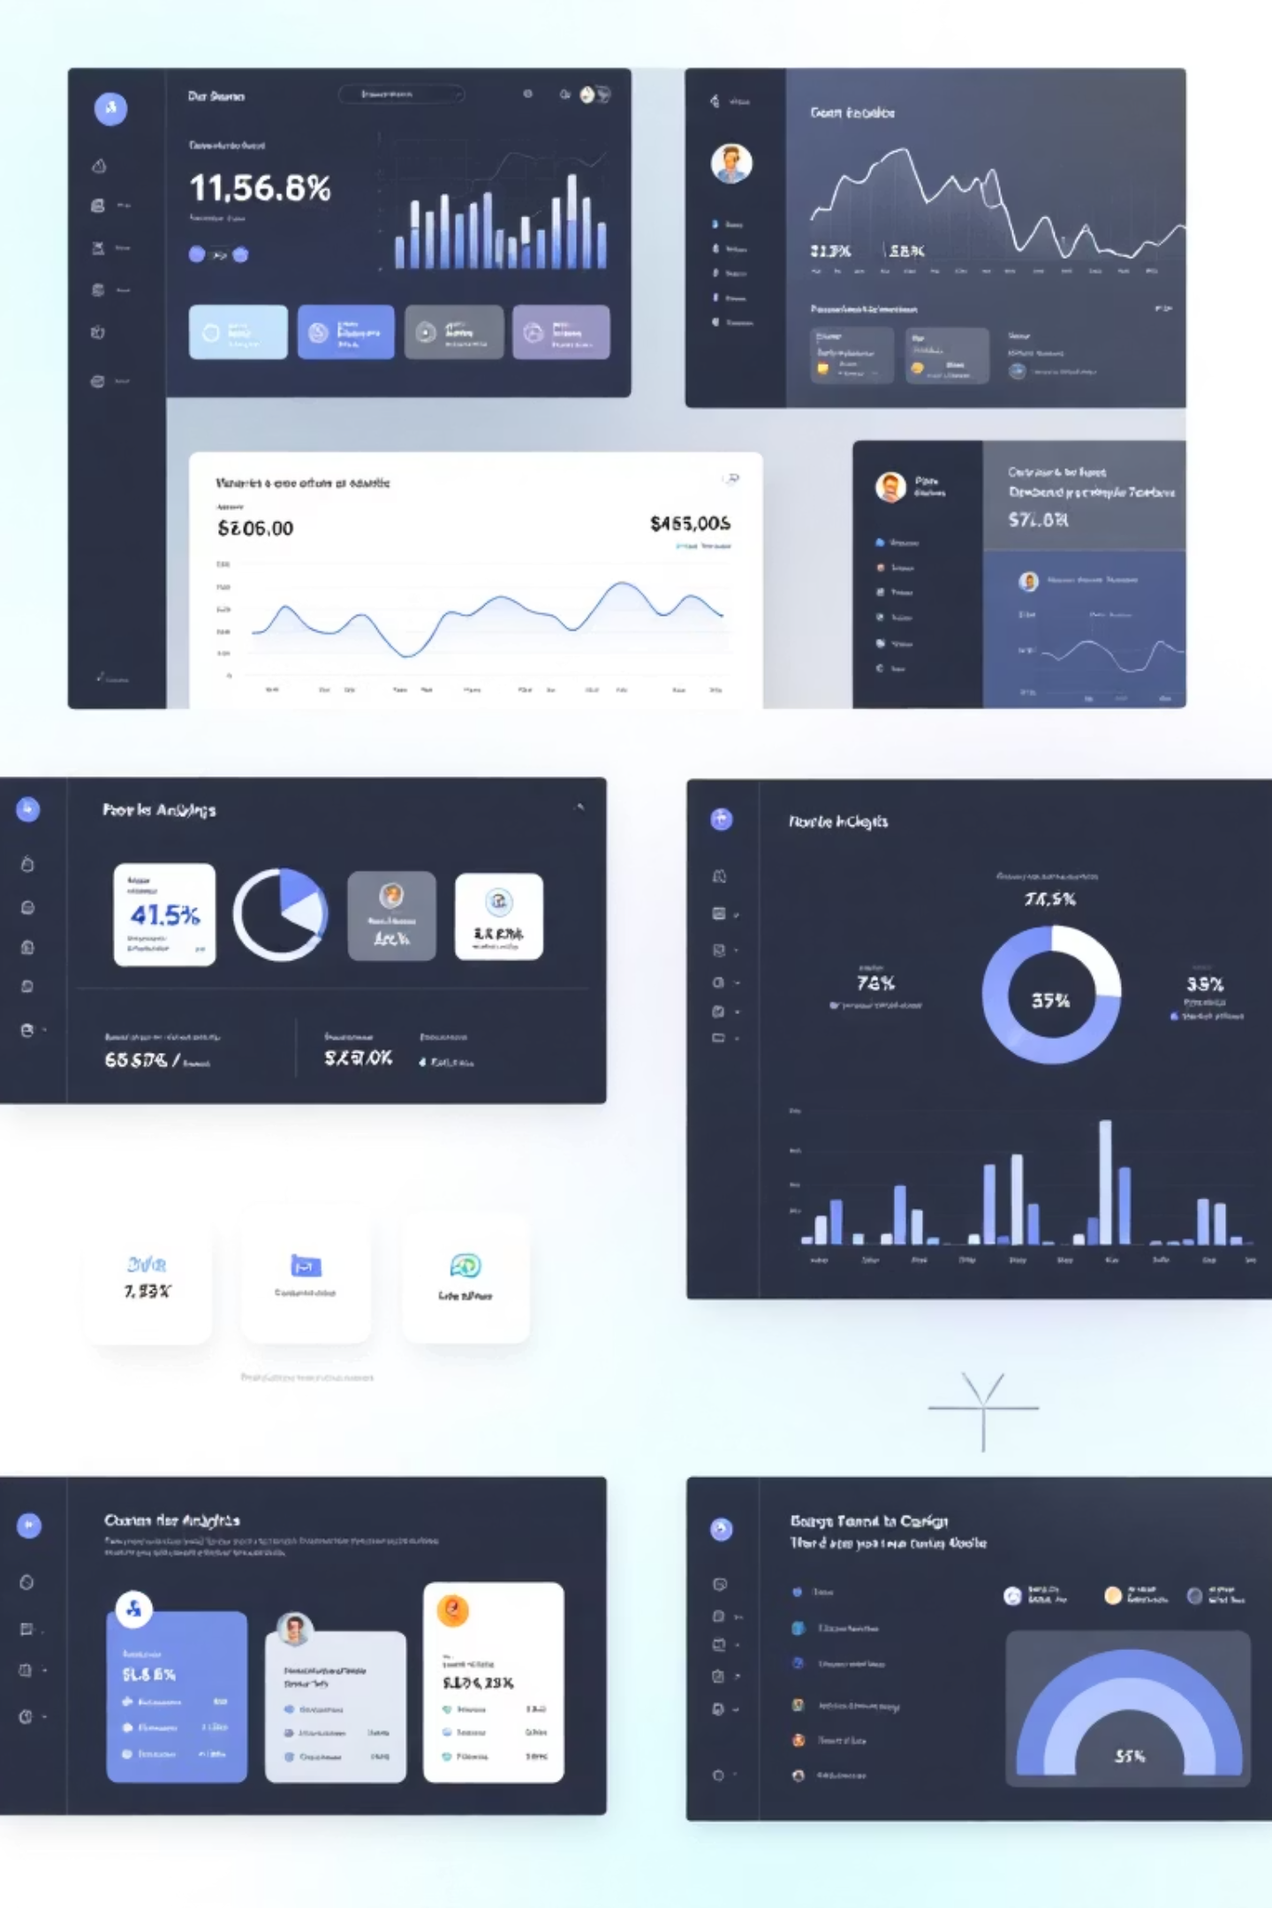
Business Intelligence & Analytics
Executive Dashboard: Real-time KPIs including booking volume, revenue, and occupancy rates
Flight Performance Analytics: On-time performance, cancellation rates, and route profitability
Passenger Analytics: Booking patterns, customer demographics, and repeat customer analysis
Revenue Reporting: Detailed revenue breakdown by route, airline, and time period
Audit Dashboard: Monitoring of system access, data modifications, and compliance violations
Predictive Analytics: Forecasting demand and optimizing pricing strategies
Custom Reports: Ad-hoc reporting capabilities for business decision-making

Slide 9
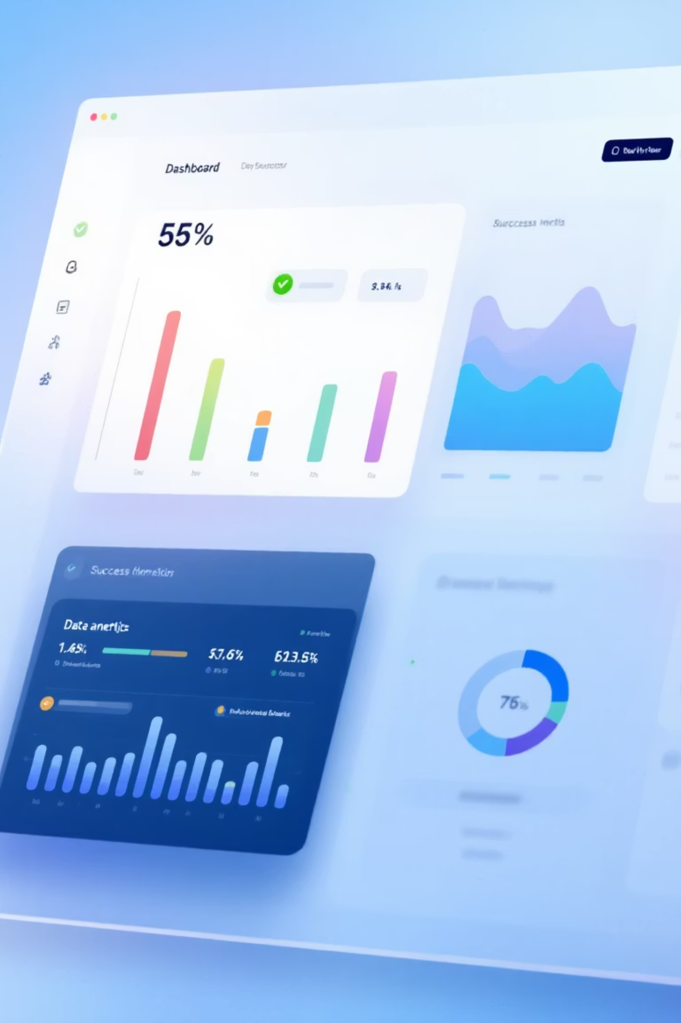
Results & Implementation Testing
Database Size: 7 tables with 500+ records per main table
Data Integrity: 100% constraint compliance and referential integrity validation
PL/SQL Components: 5+ procedures, 5+ functions, 3+ packages, and 6+ triggers implemented
Test Coverage: Comprehensive testing of all CRUD operations and business logic
Performance: Query optimization with indexes achieving sub-second response times
Audit Logging: 1000+ audit trail entries demonstrating complete transaction tracking
Error Handling: All edge cases tested and documented with clear error messages
Trigger Testing: Verified restriction rules blocking weekday/holiday modifications

Slide 10

Conclusion & Key Achievements
Successfully developed a production-ready flight booking and management system
Implemented comprehensive database design with 3NF normalization and data integrity
Created robust PL/SQL components for automated business process management
Established advanced security and auditing mechanisms for compliance and accountability
Delivered business intelligence capabilities for data-driven decision-making
Demonstrated mastery of Oracle database development and PL/SQL programming
Lessons Learned: Importance of data normalization, comprehensive testing, and security
Future Enhancements: Mobile app integration, real-time notifications, and predictive analytics

